Slide 1
Introduction & ex-Work Environment

Slide 2
Topics of today’s class
About me & my previous company and environment
Some pictures of the work environment
My day to day activities
Some early suggestions
Questions

Slide 3
Some of the questions I got from you:
Who are you?
What are you doing? How are you?
Will you be teaching us?
When will you be teaching us?
What will you be teaching us?
Why are you not teaching us?
Who do you work for?
Are you here to just say hi?

Slide 4
WHO AM I?
Gurhan / Full time Cybertek Instructor / B4
What are my responsibilities here in Cybertek Chicago Location?
Why I didn’t start teaching here until now?
Notes:
Why I didn’t start teaching?

Slide 5
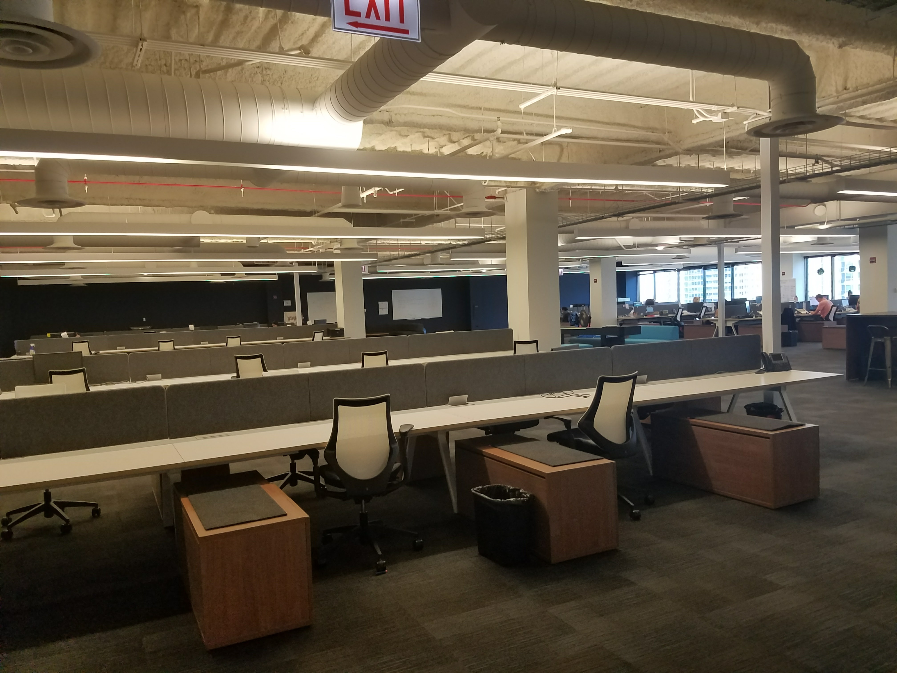

Slide 6
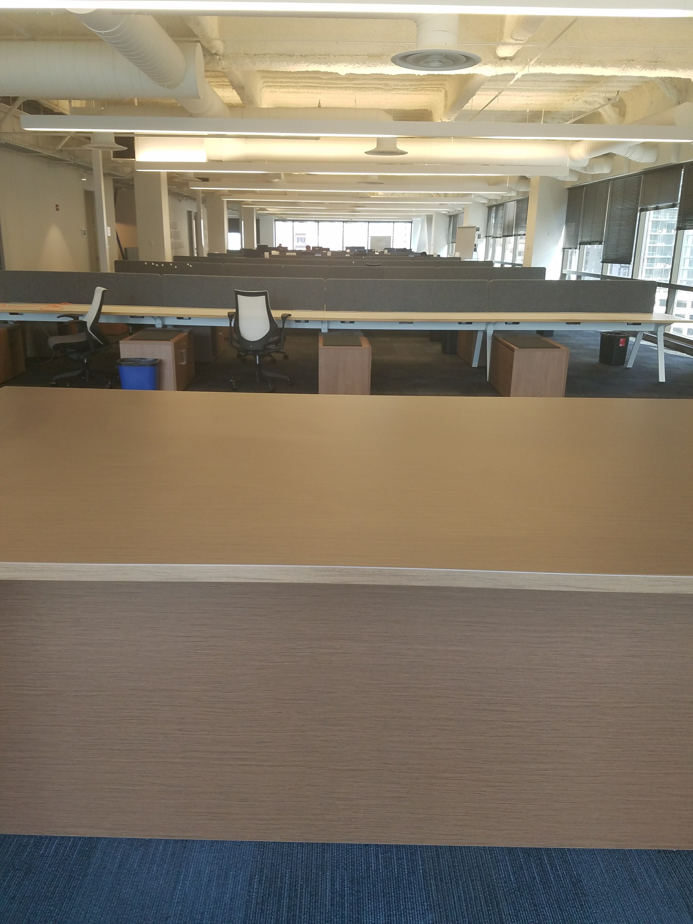

Slide 7
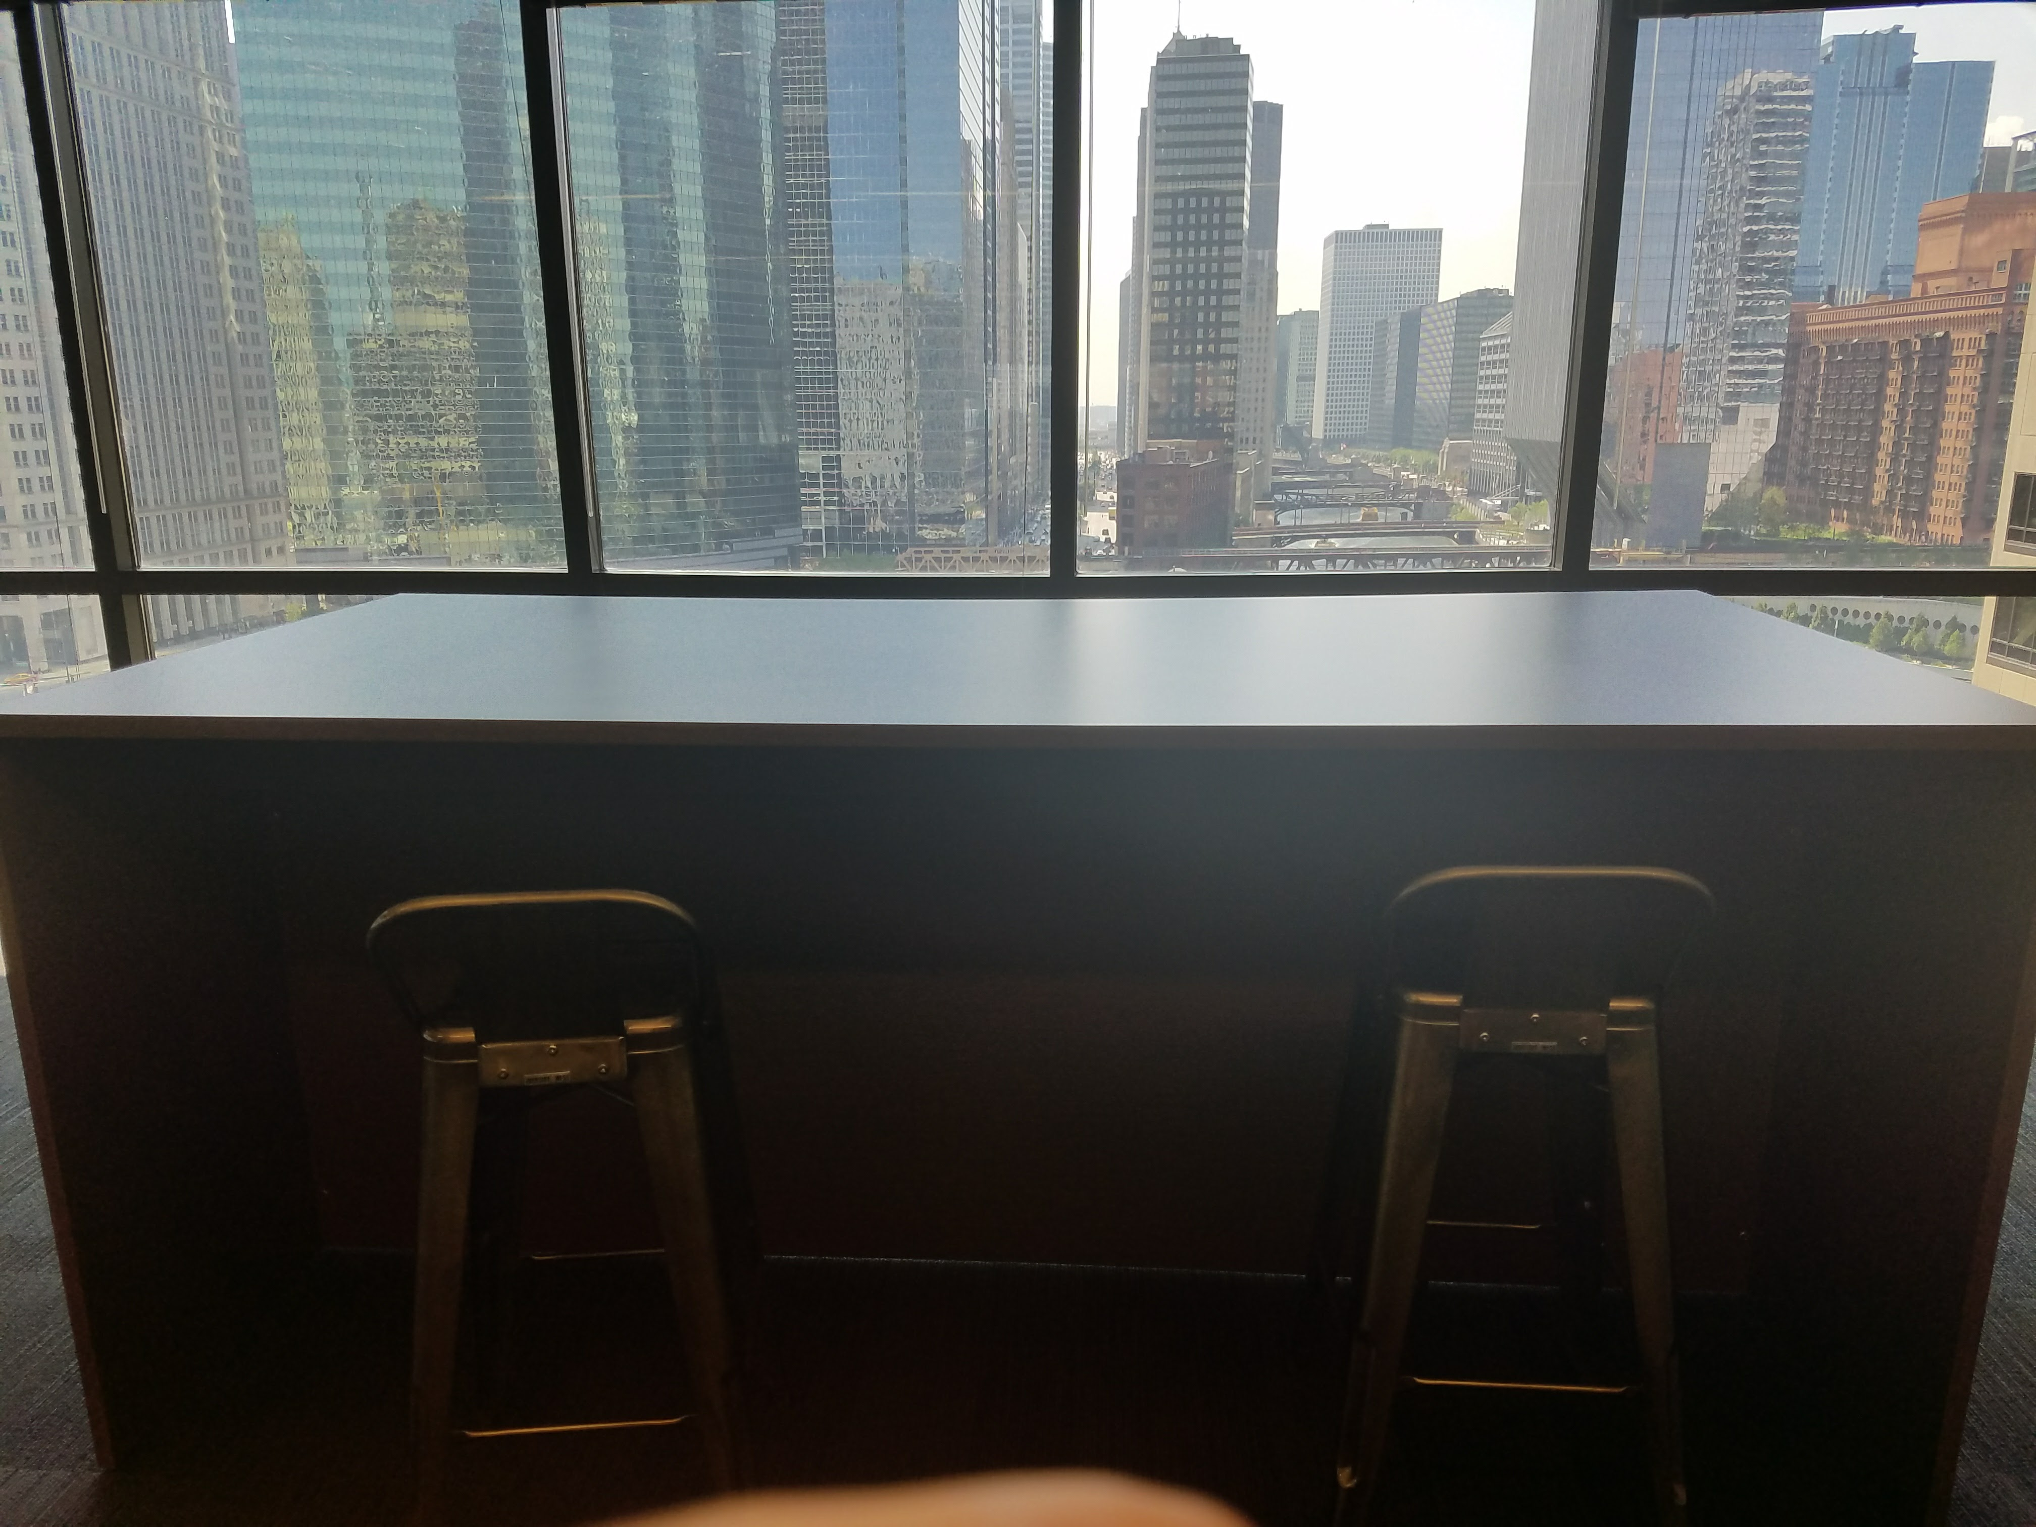

Slide 8
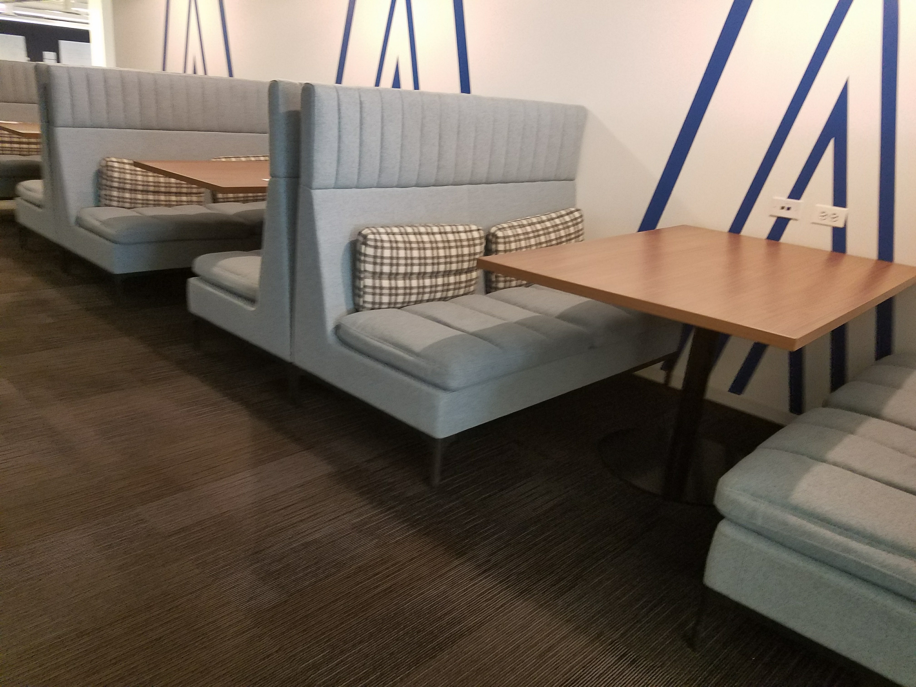

Slide 9
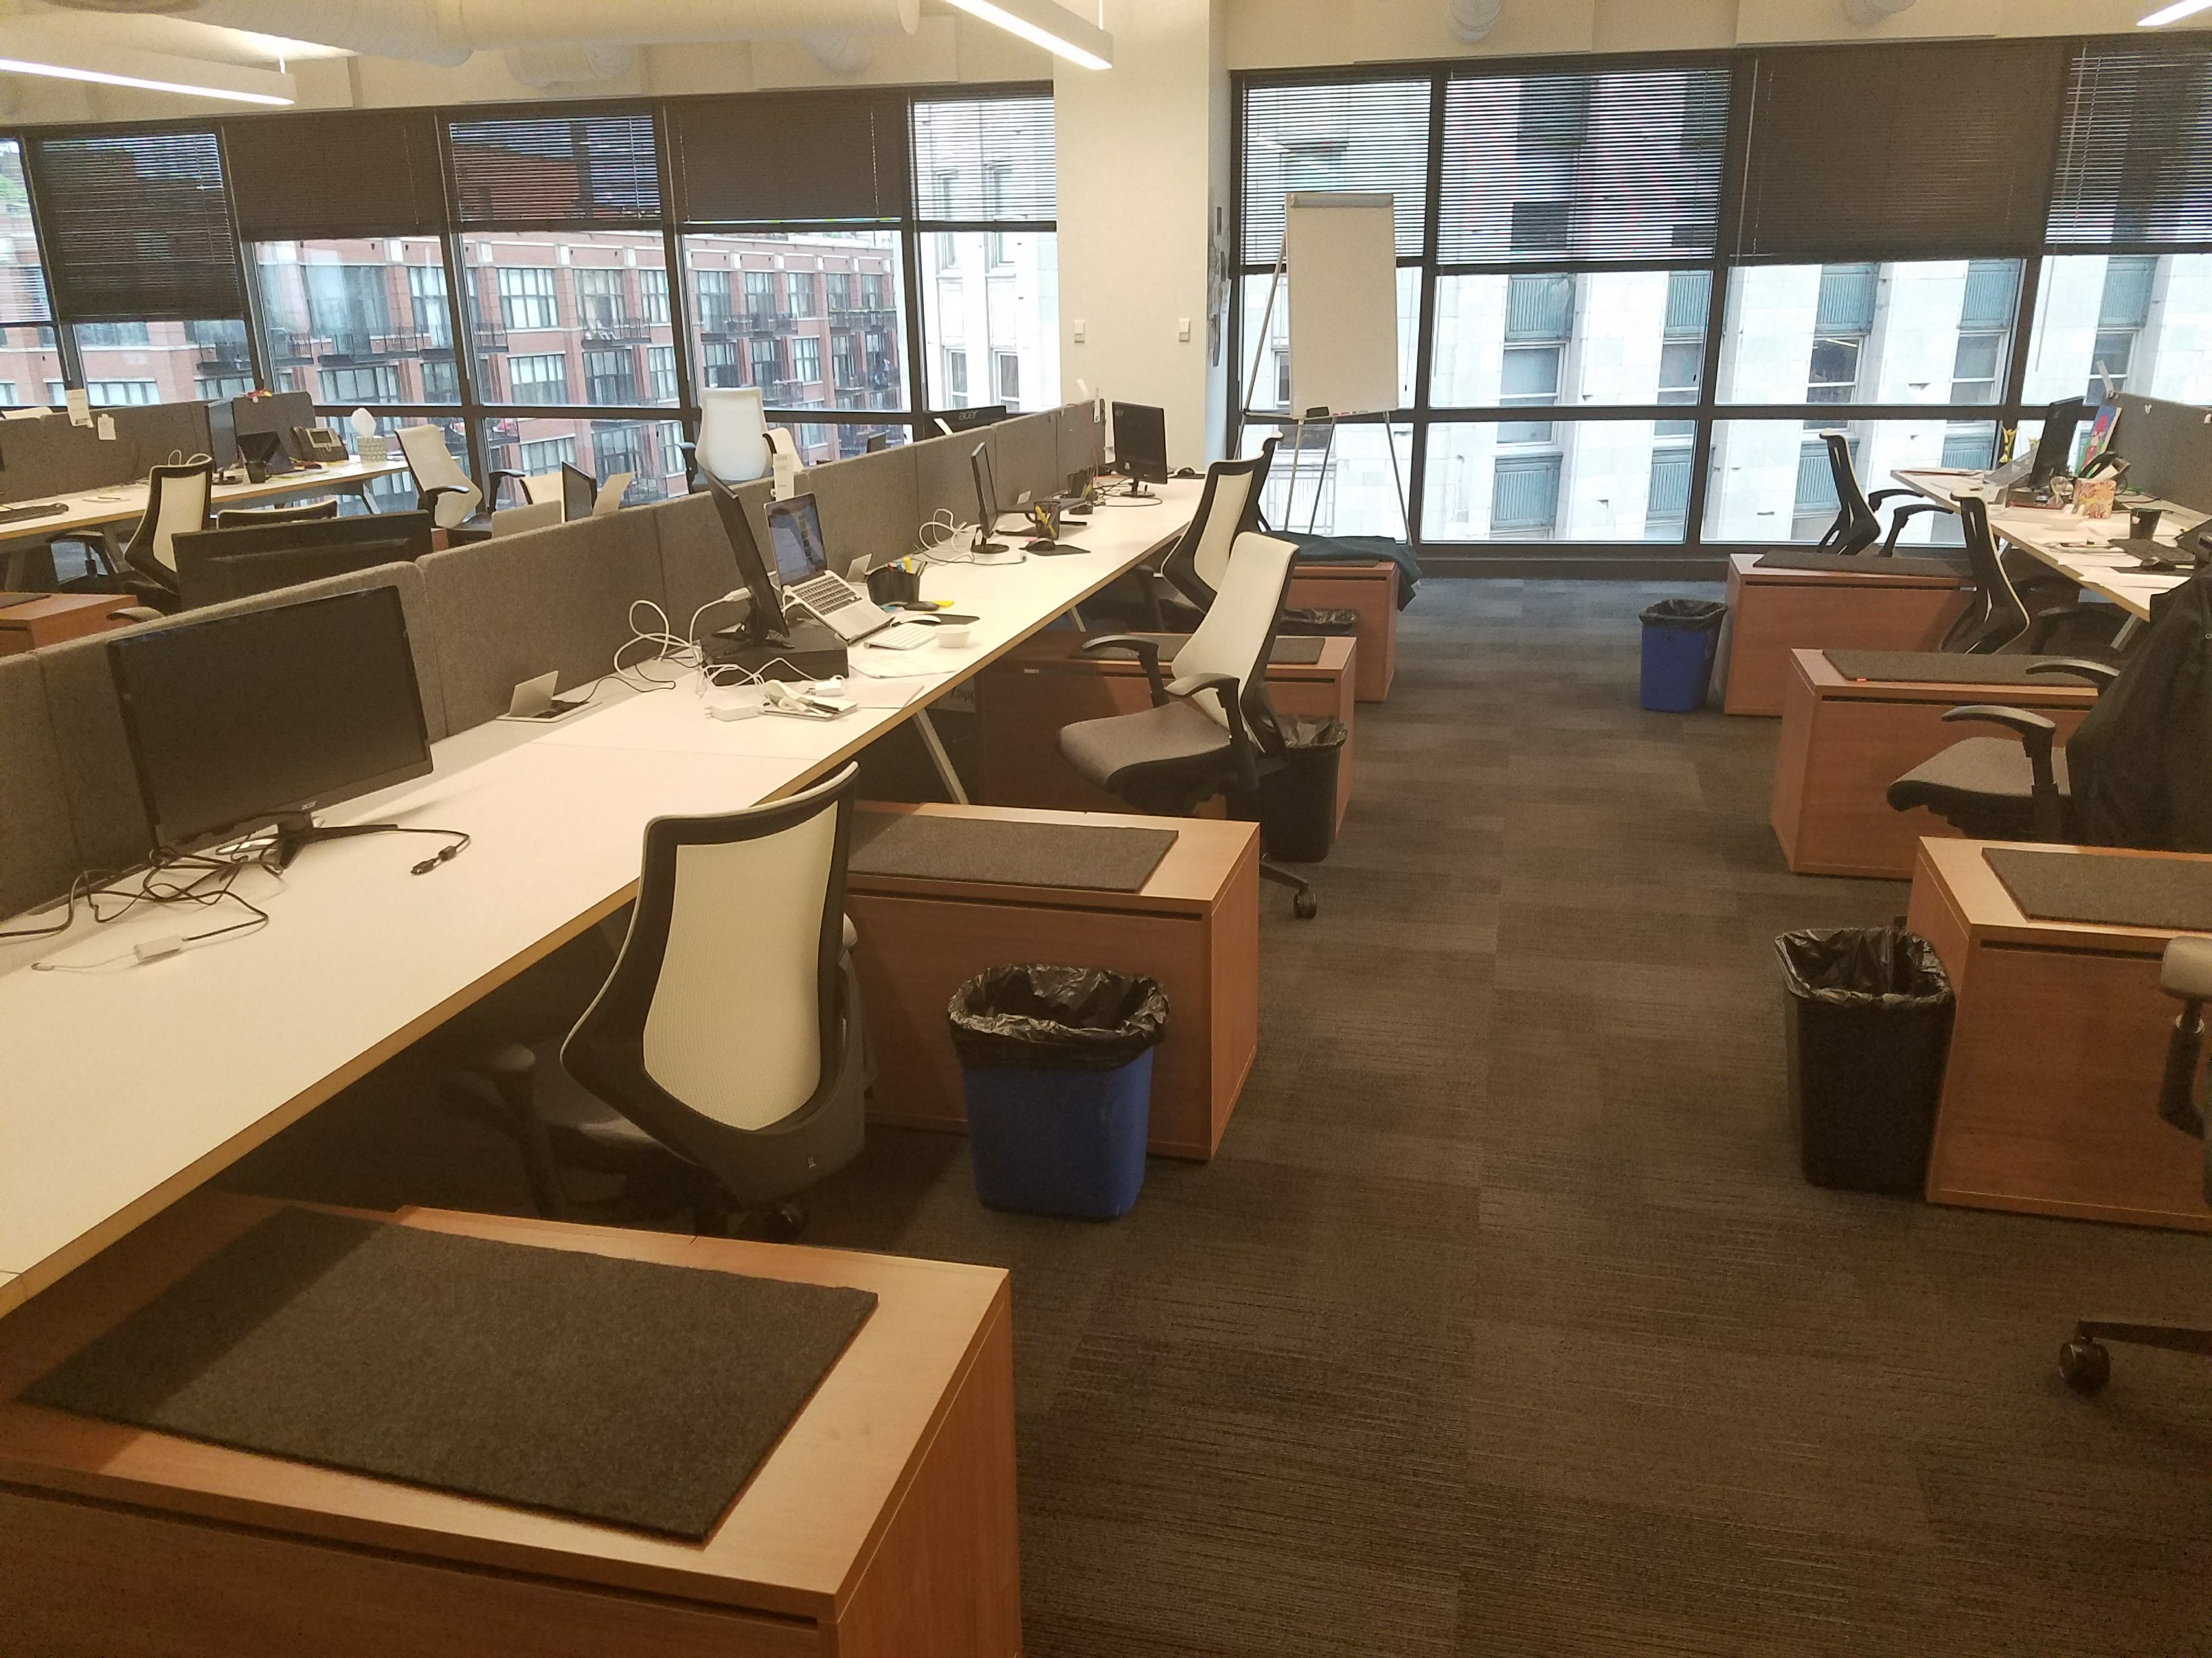

Slide 10
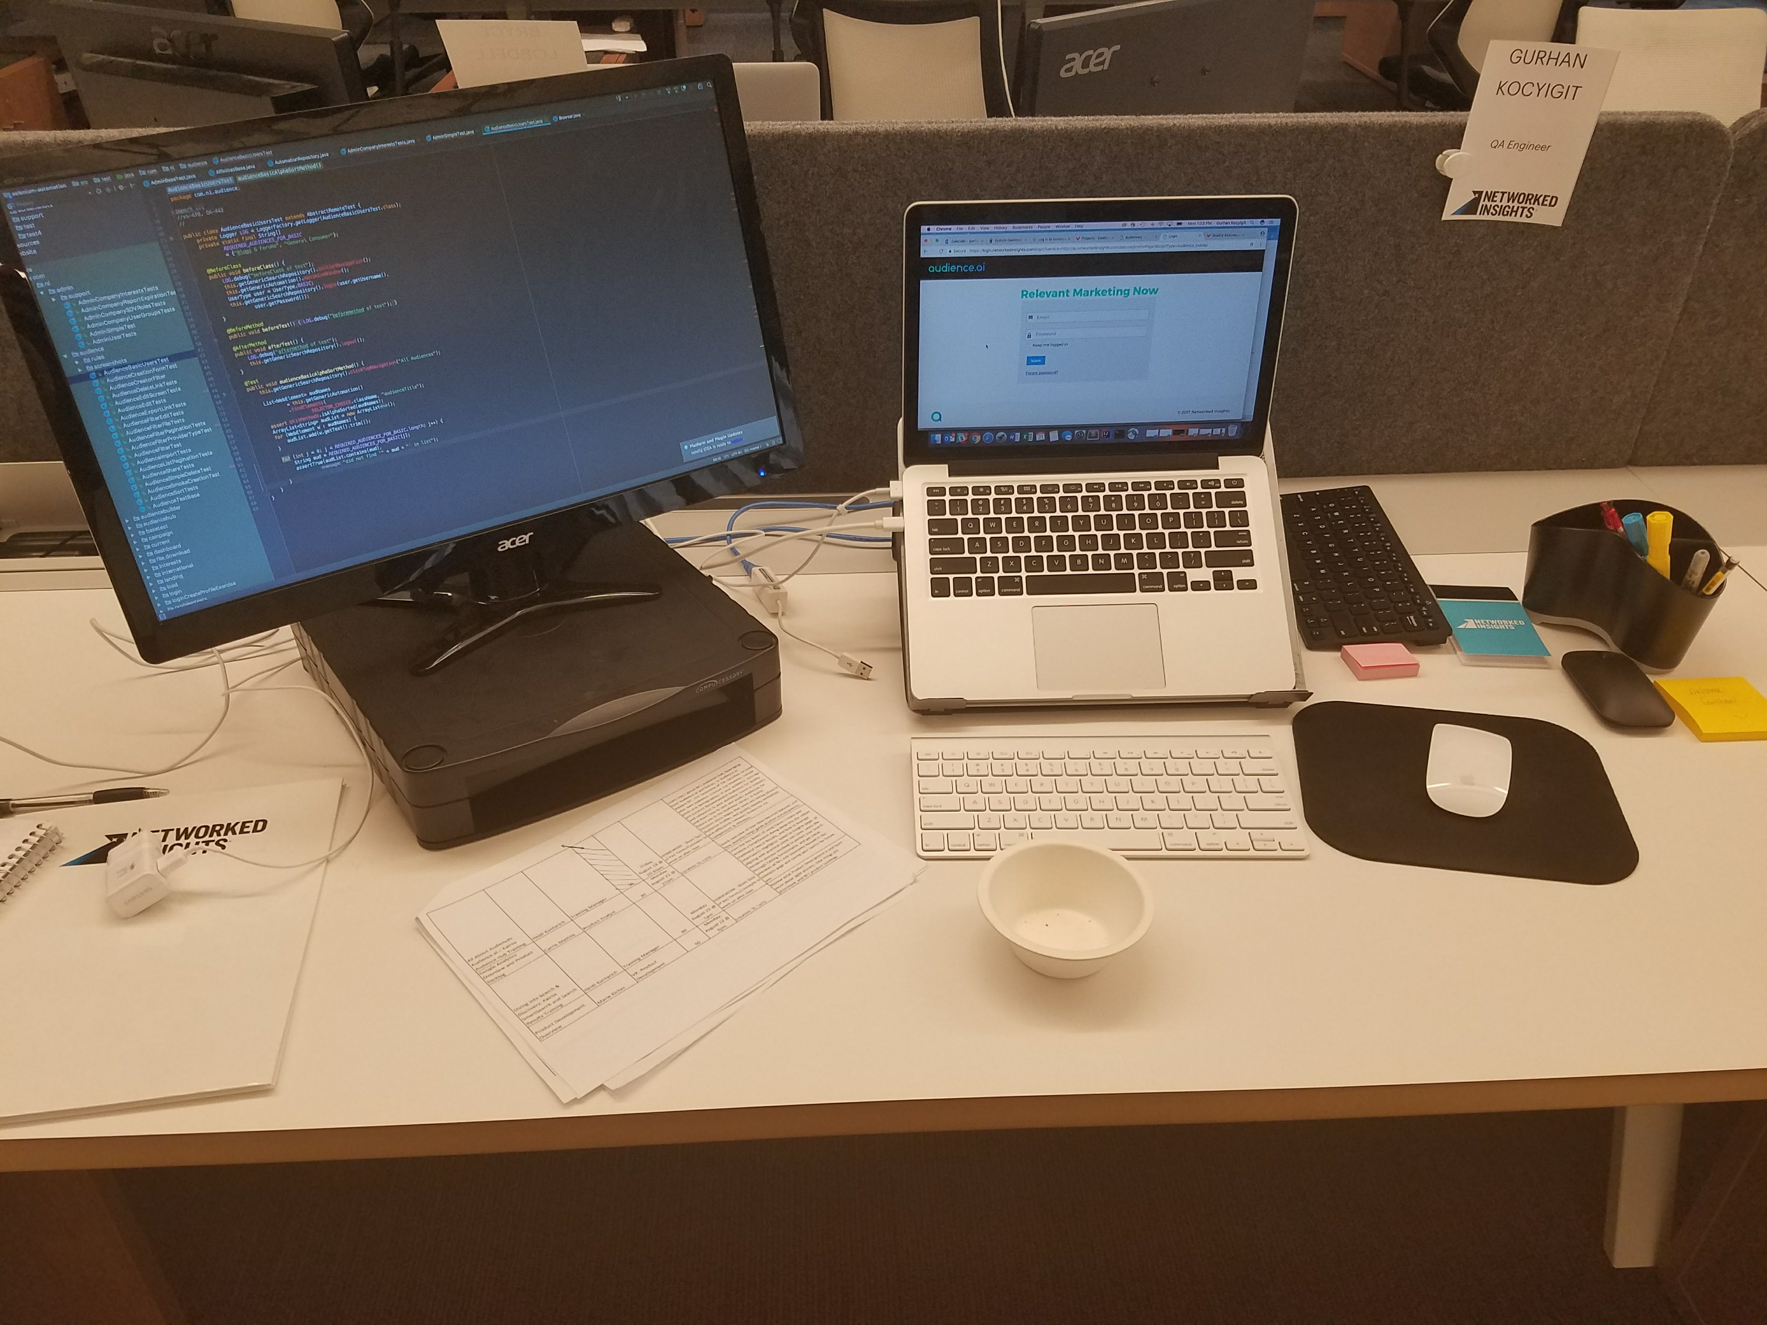

Slide 11
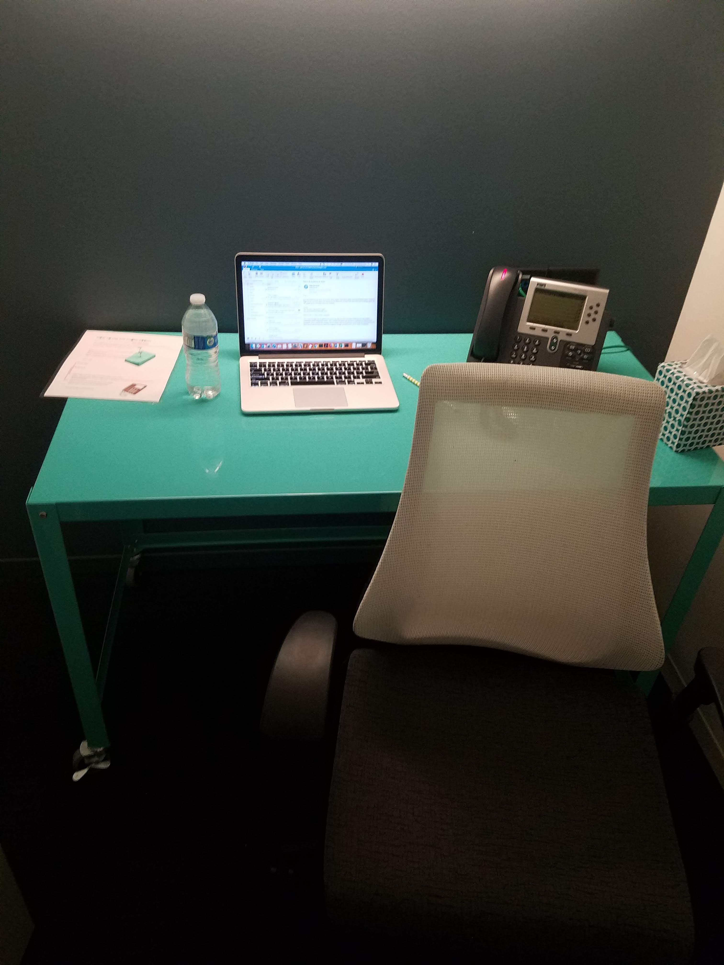

Slide 12
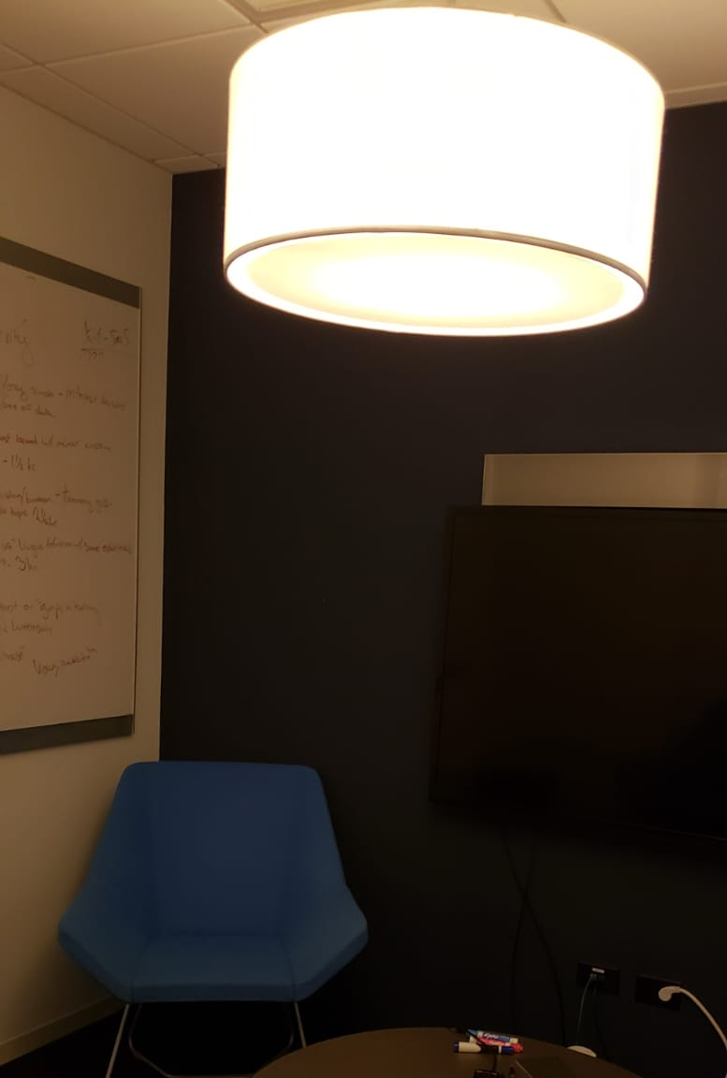

Slide 13
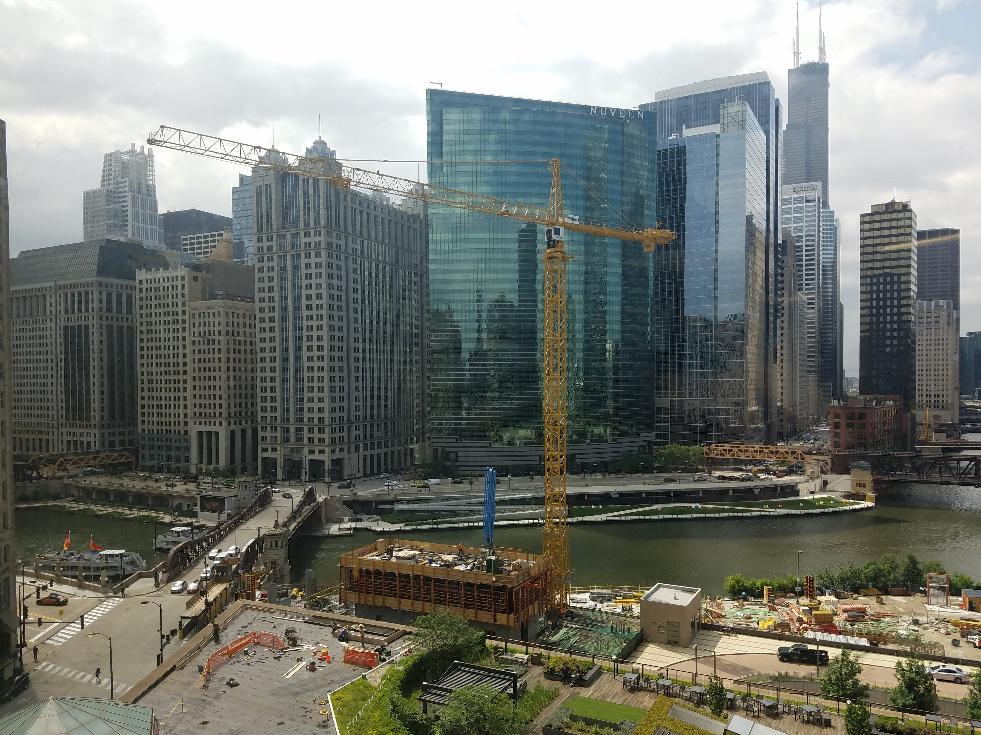

Slide 14
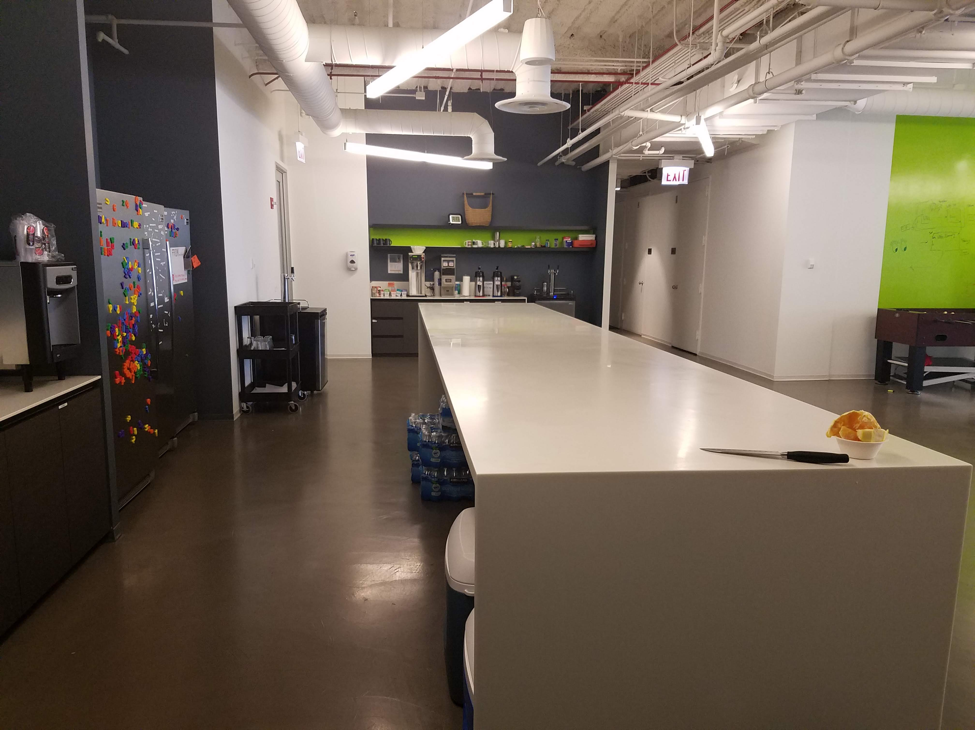

Slide 15
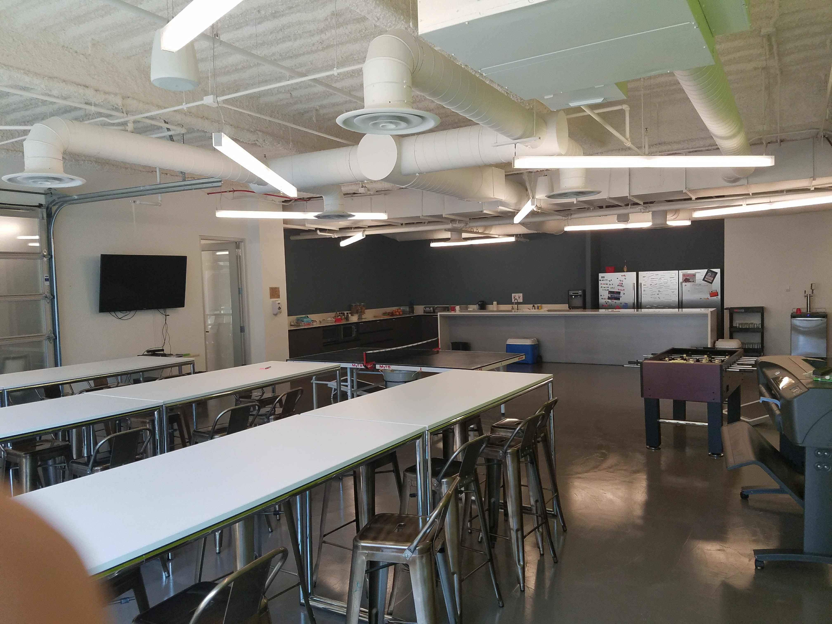

Slide 16
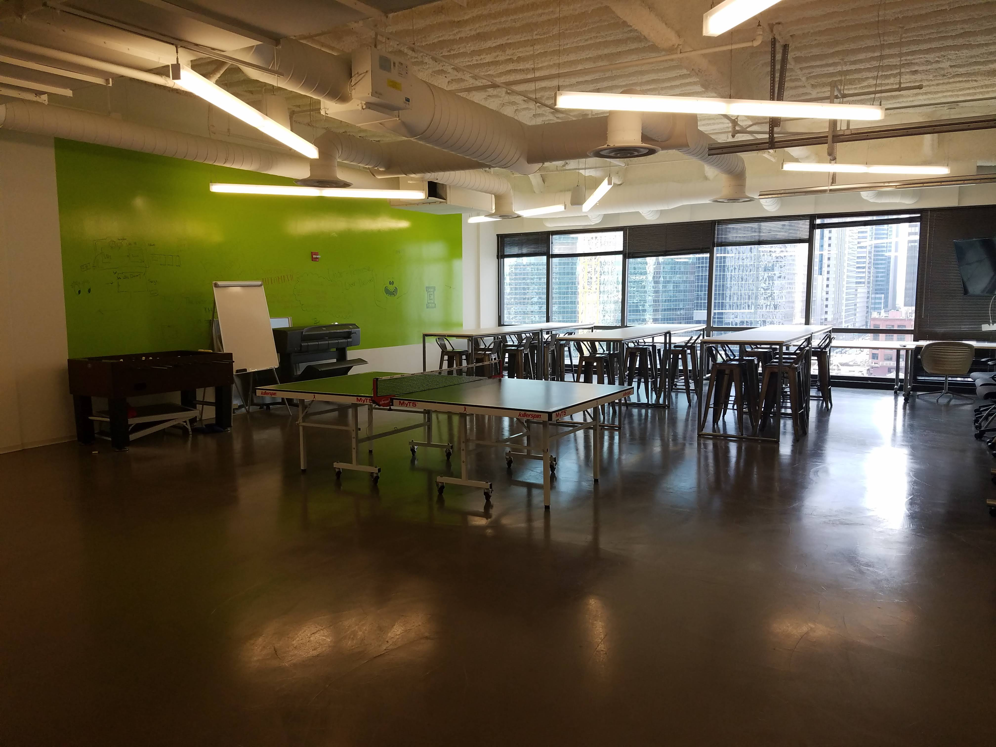

Slide 17
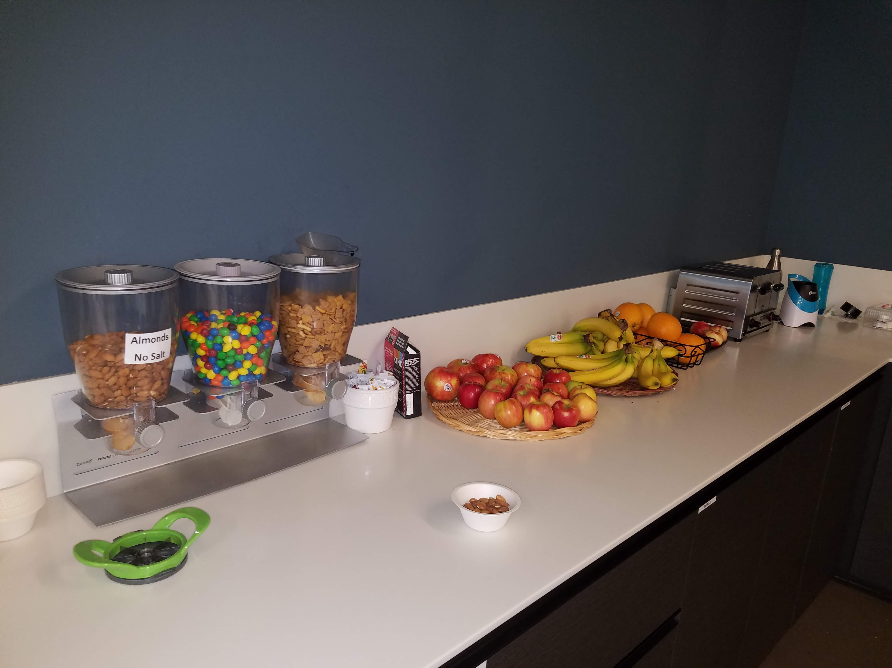

Slide 18
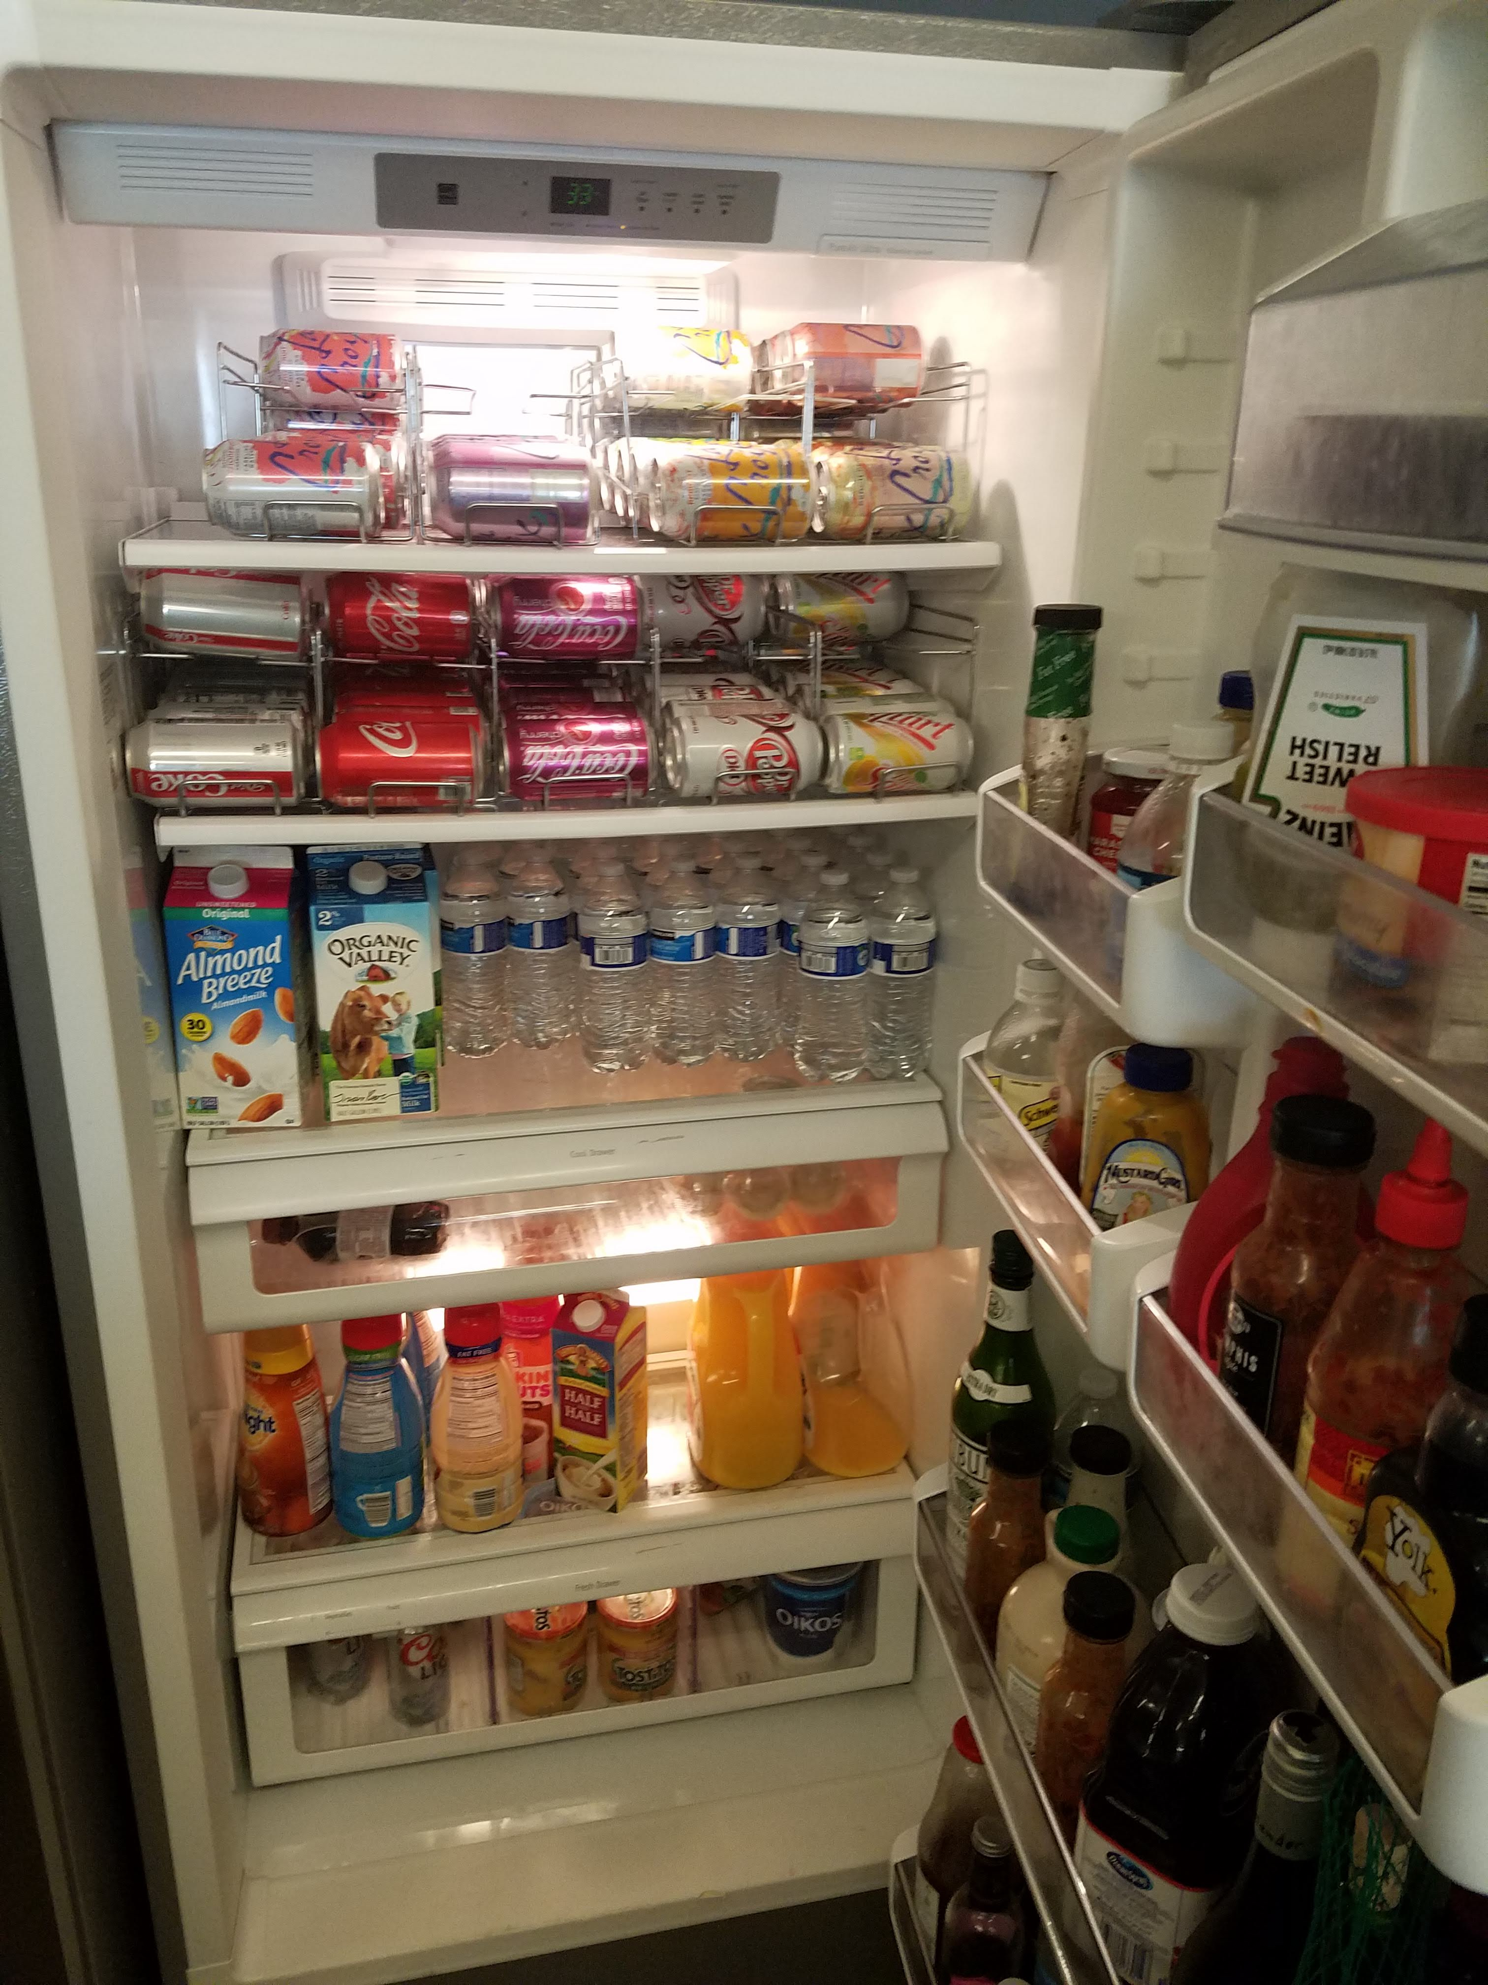

Slide 19
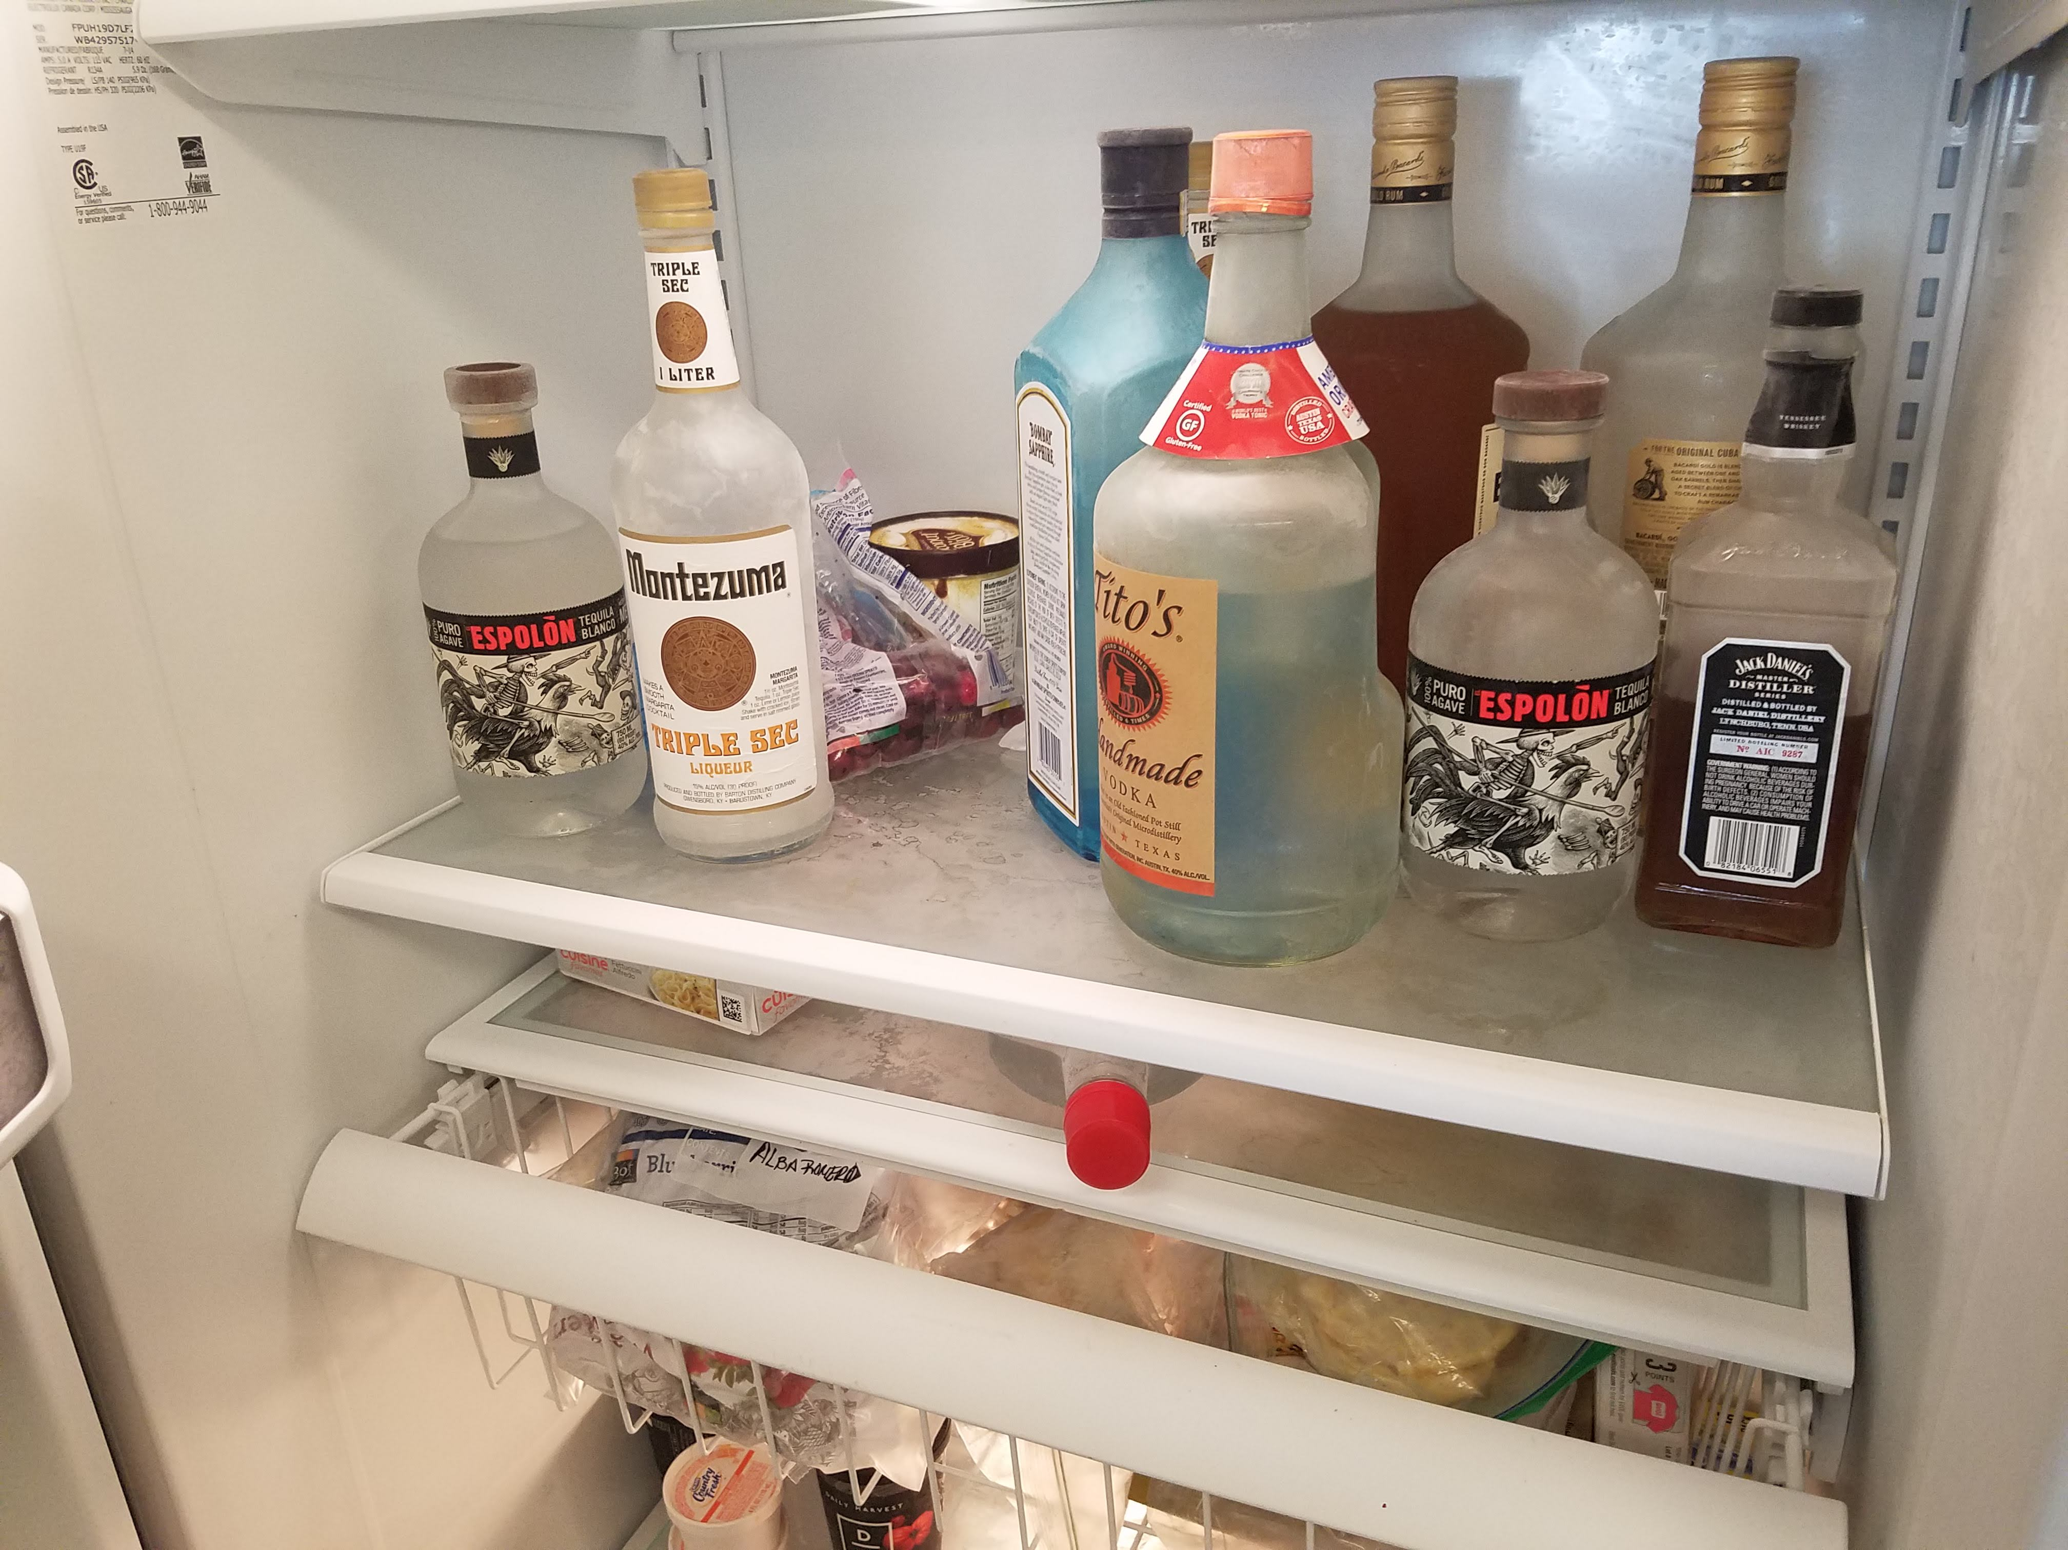

Slide 20
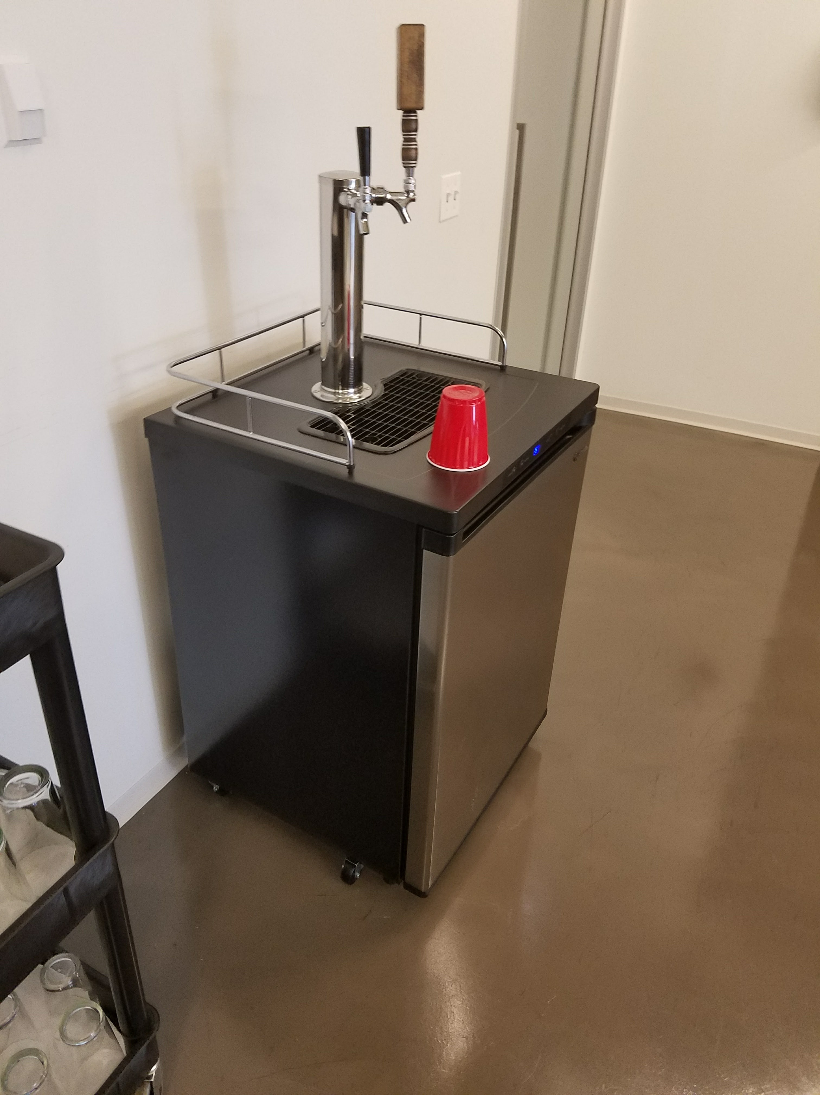

Slide 21
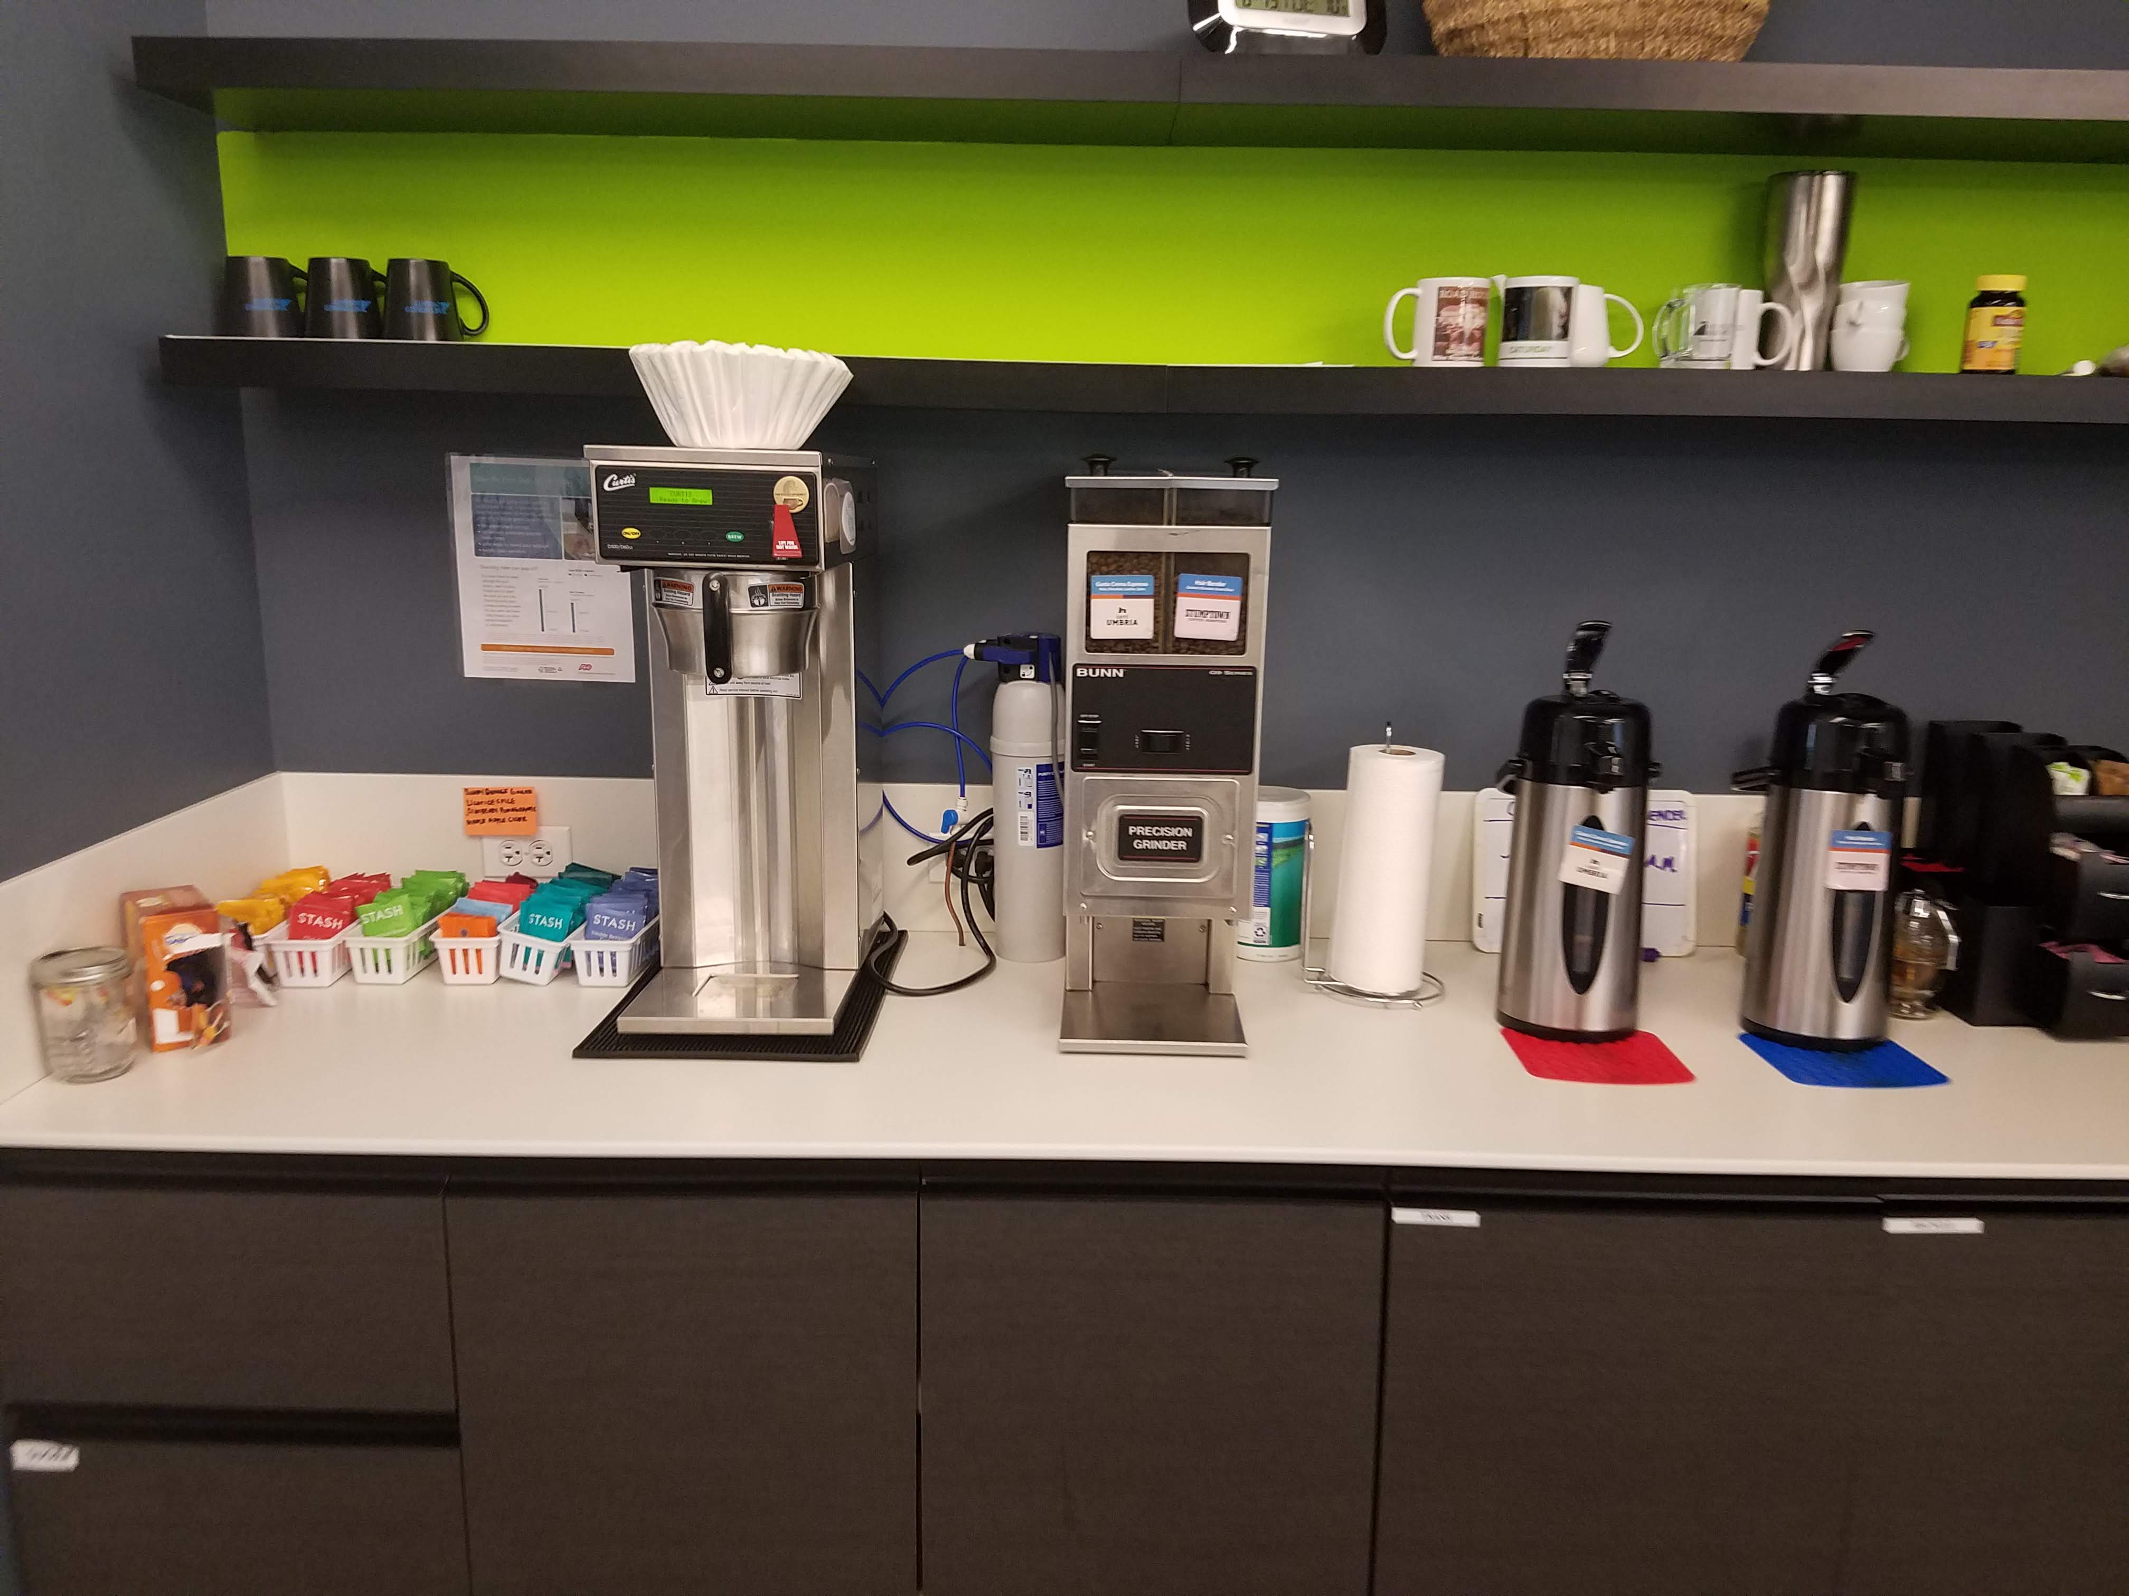

Slide 22
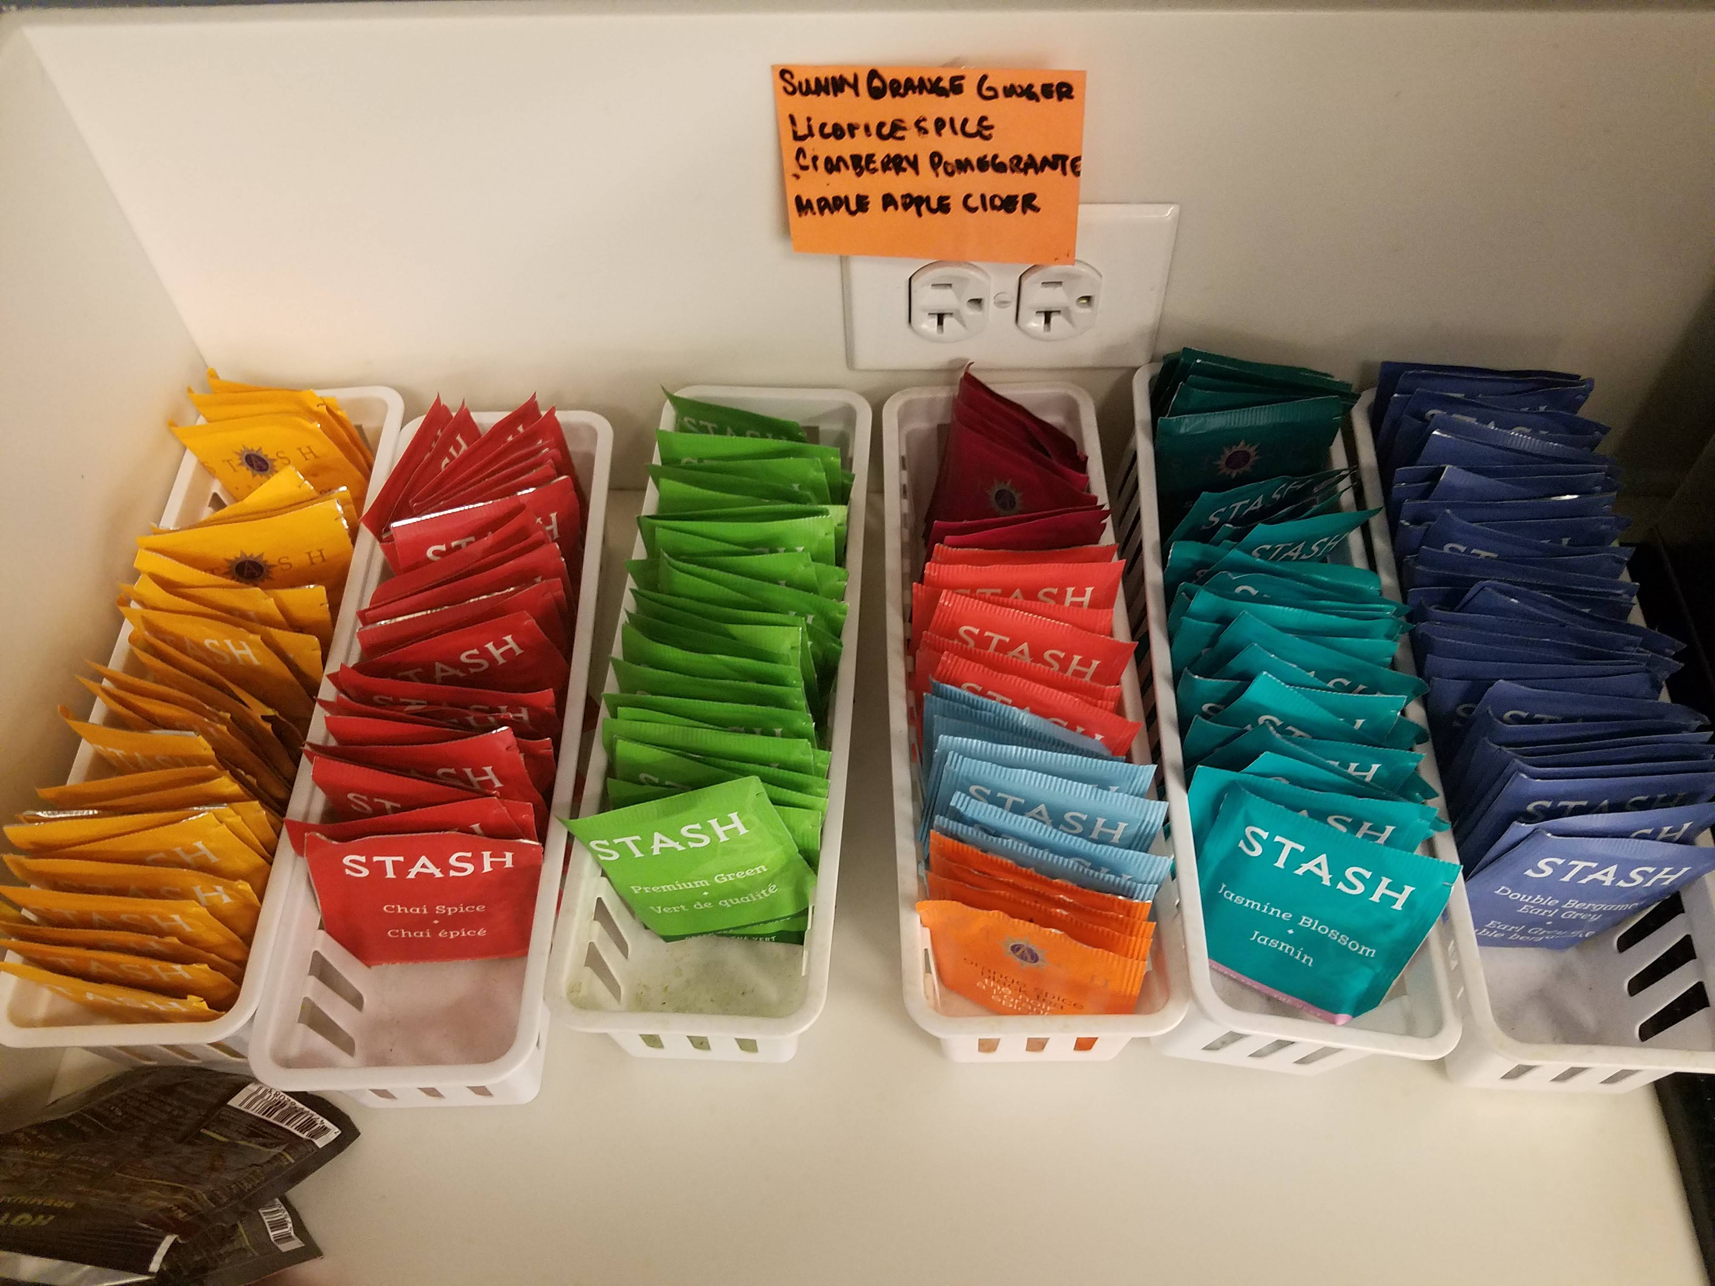

Slide 23
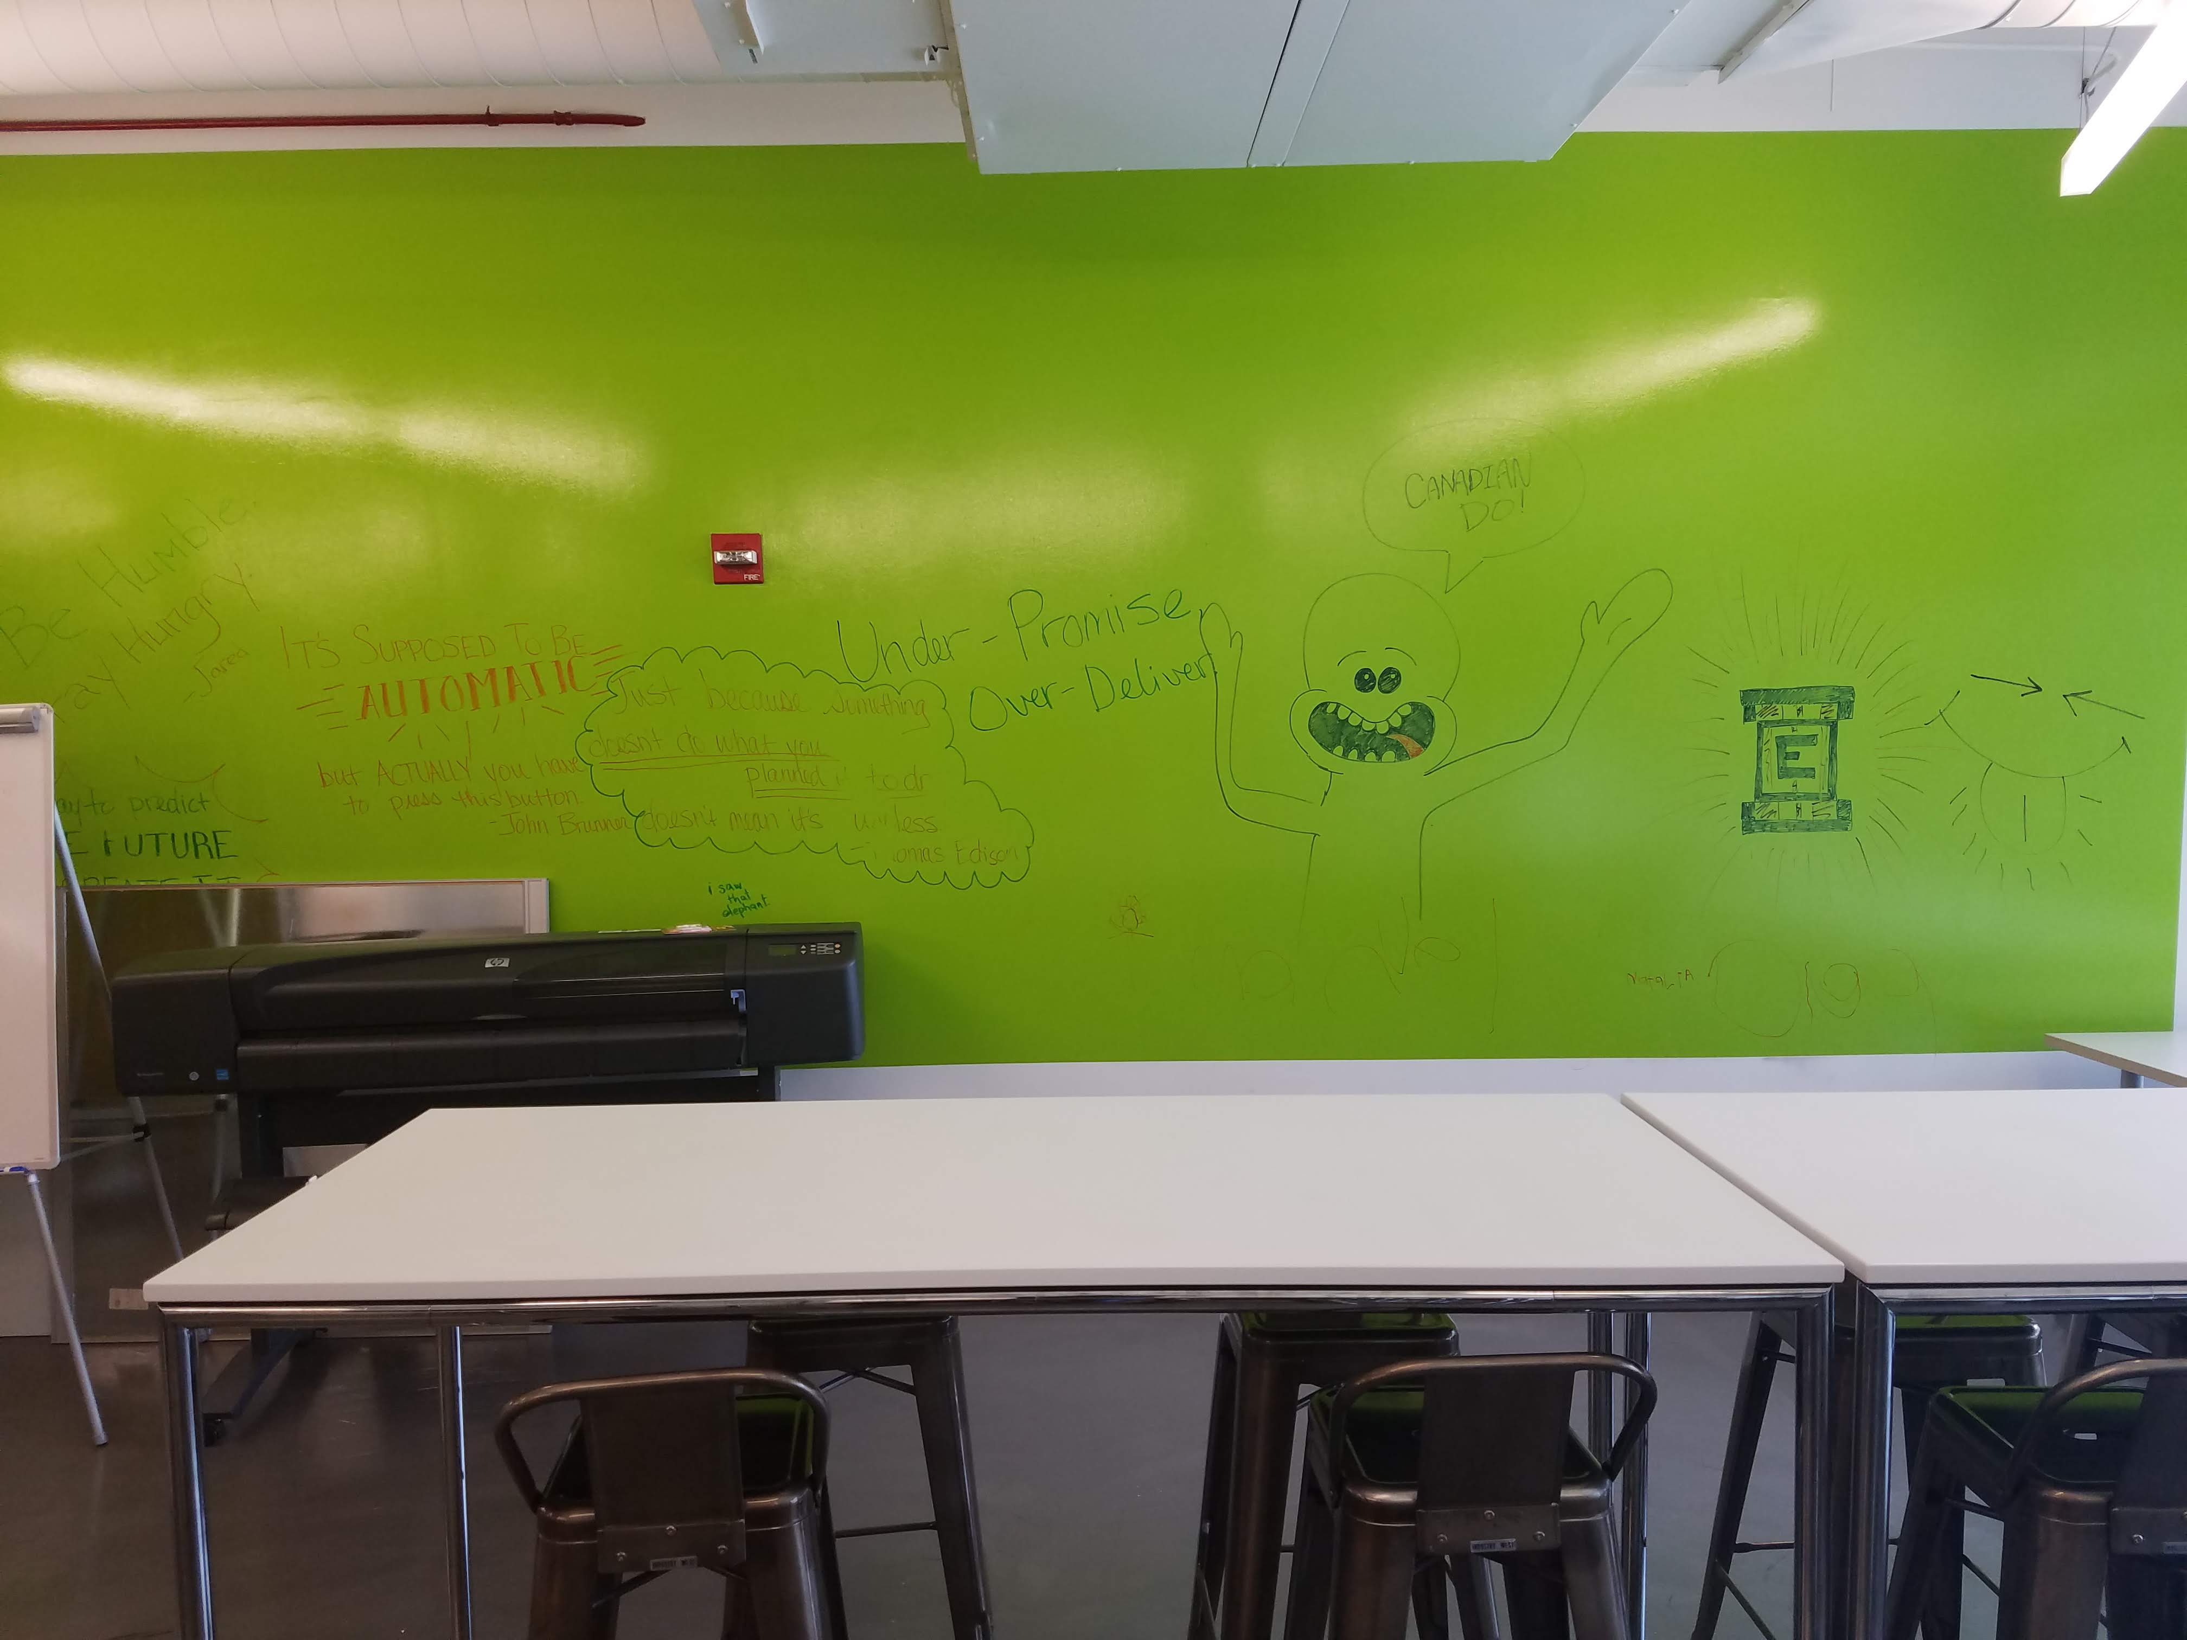

Slide 24
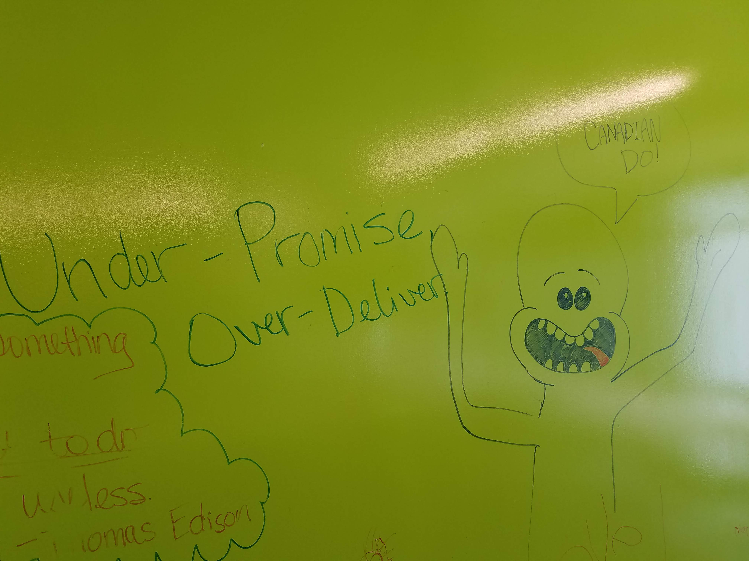

Slide 25

Some benefits I had
Unlimited PTO
Unlimited WFH
Unlimited sick days
No tracking of how many hours of work you did daily
Contract literally said: OK. You are an adult…
Free health insurance. No payments whatsoever.
Annual bonus of 10-16% after performance review
Some as cash
Some as company shares
Company matches up to 4% for 401K
Pre-tax deduction for commuting and parking money

Slide 26
A Work Day
Come in between 9.00am-9.45am
Check sanity (smoke) test results to see if there is anything wrong
Attend 9.45am-10.00am stand up meeting with the team
Share what I did yesterday, what I will be doing today, and if I have any blockers
I check my e-mails and Jira board for any updates, respond accordingly
I start working on whatever task I have
LUNCH/ work / COFFEE / work/
LEAVE around 4.30pm

Slide 27
What is the most important skill of a software tester?
Be able to communicate through any issues
Environment down
Application down
Not enough documentation
Not enough information about the task
Be able to work with limited time
Regression for the last day
Any other issues that may come up right before deploy

Slide 28
Be able to think outside of the box
It is not just about clicking buttons and verifying
There is more to it even for just even manual testing
Different tools: Jira, PostMan (API testing), Kibana, Docker, Tomcat Server
Try to be critical with your everyday task, so that you can improve your critical thinking
VIDEO

Slide 29
EARLY SUGGESTIONS FOR SELF-SKILL DEVELOPMENT
Start practicing interview practical java questions
Be able to VERBALLY explain java concepts ( for java: Abstract, Interface, polymorphism… etc.)
Record yourself and listen to yourself to see if there is anything you can improve.
Be able to practically answer the java questions => SOME JAVA QUESTIONS
Repl.it tasks, HackerRank, CodingBat etc.
Start listening to “Java interview questions” (maybe this one after covering OOP concepts)
Pay attention to Thursday classes, and start listening to soft skill related questions:
One good source for soft skills => PORTNOV
TouchTyping

Slide 30
What is touch typing?
Touch typing is typing without looking to find the keys.
After practicing you will have enough muscle memory to touch type.

Slide 31
Why touch typing is important?
Typing is what you will be doing in your professional and personal life
This could be one of the best skills you can get as an IT professional
It is in the professional nature of IT jobs.
It removes a great impediment for you; looking at the keyboard for typing.
When you learn how to drive, you don’t look at the gas and brake pedals every time you use them. They are there, and you just use them.

Slide 32
How to learn and practice?
To Learn
http://thetypingcat.com/ ⬅ Practices to gain muscle memory
https://www.keybr.com/
More sites from here ➔ LINK
To Practice
Play.typeracer.com ⬅ One of the most popular ones
Zty.pe ⬅ Different UI (Gaming Style)
https://10fastfingers.com/

Slide 33
Just remember try not to type fast
Try to type with minimal mistakes and practice as much as you can
When you start building a muscle memory, you will start typing faster automatically
If you start practicing only 15 mins today until the end of your course
You will have 1800 minutes practiced in total.

Slide 34
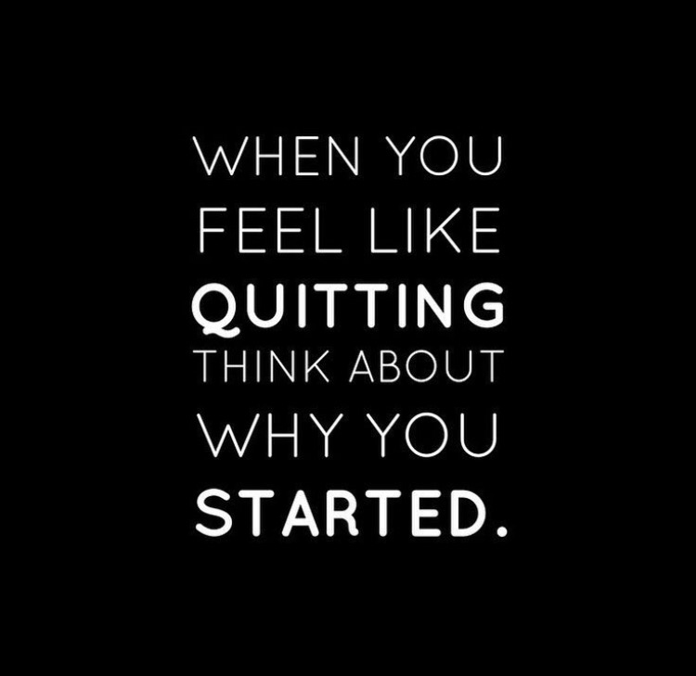

Slide 35

Any questions?

Slide 36


